Slide 1
Comparison of wet only samplers at EMEP sites in the UK
22nd Task Force on Measurement and Modelling Meeting
11th May 2021
Keith Vincent, Matthew Jones, Chris Conolly and Christine Braban

Slide 2
Outline
Rainwater composition networks in United Kingdom
Replacement of wet only samplers
Compare wet only and bulk concentrations
Conclusions
Notes:
Main content slide. Other slide layouts are available via Home tab > Slides group > Layout.
Edit the project number, confidential level (and client name), date and document number (RD or for proposals use B&T number) in the footer via View tab > Presentation Views group > Slide Master. Be sure to scroll all the way up to the top “slide master” to edit these, as you can not edit them in the “layouts”. Also go there to remove or edit the “INTERNAL UNAPPROVED DRAFT” tag before releasing to clients.

Slide 3
Context: Rainwater networks in the United Kingdom
National monitoring of rainwater composition since mid 1980s.
Original focus on acidification now eutrophication
Two EMEP Supersites
Forty one bulk rainwater collectors
Reporting to EMEP
National deposition mapping
Article 9 NECD Submission
Notes:
Main content slide. Other slide layouts are available via Home tab > Slides group > Layout.
Edit the project number, confidential level (and client name), date and document number (RD or for proposals use B&T number) in the footer via View tab > Presentation Views group > Slide Master. Be sure to scroll all the way up to the top “slide master” to edit these, as you can not edit them in the “layouts”. Also go there to remove or edit the “INTERNAL UNAPPROVED DRAFT” tag before releasing to clients.

Slide 4
Network description and Data Archive
Notes:
Main content slide. Other slide layouts are available via Home tab > Slides group > Layout.
Edit the project number, confidential level (and client name), date and document number (RD or for proposals use B&T number) in the footer via View tab > Presentation Views group > Slide Master. Be sure to scroll all the way up to the top “slide master” to edit these, as you can not edit them in the “layouts”. Also go there to remove or edit the “INTERNAL UNAPPROVED DRAFT” tag before releasing to clients.

Slide 5
Objective of study: to assess Digitel sampler performance against Eigenbrodt
Eigenbrodt wet only samplers had been in operation:
Since 2016 at Chilbolton (and formerly Harwell since March 2009)
Since June 2006 at Auchencorth Moss
Needed replacing and we wanted to check performance of replacement sampler (Digitel)
Original plan to run in parallel for a couple of months – extended for a couple years
Also compare to the bulk rain collectors and rain gauges collocated at both sites
Notes:
Main content slide. Other slide layouts are available via Home tab > Slides group > Layout.
Edit the project number, confidential level (and client name), date and document number (RD or for proposals use B&T number) in the footer via View tab > Presentation Views group > Slide Master. Be sure to scroll all the way up to the top “slide master” to edit these, as you can not edit them in the “layouts”. Also go there to remove or edit the “INTERNAL UNAPPROVED DRAFT” tag before releasing to clients.

Slide 6
Each site is collocated with bulk samplers and rain gauges
Rain gauge volumes for Auchencorth Moss obtained from tipping bucket 30 minute averages
http://dap.ceda.ac.uk/badc/deposited2017/auchencorth_moss_met/data/AU_MetData
Aggregated to daily values
Rain gauge volumes for Chilbolton obtained from Chilbolton Facility for Atmospheric and Radio Research (STFC)
As average of four “rain gauges” at 1 minute resolution, averaged to 15 minute and then aggregated to daily values.
Notes:
Main content slide. Other slide layouts are available via Home tab > Slides group > Layout.
Edit the project number, confidential level (and client name), date and document number (RD or for proposals use B&T number) in the footer via View tab > Presentation Views group > Slide Master. Be sure to scroll all the way up to the top “slide master” to edit these, as you can not edit them in the “layouts”. Also go there to remove or edit the “INTERNAL UNAPPROVED DRAFT” tag before releasing to clients.

Slide 7
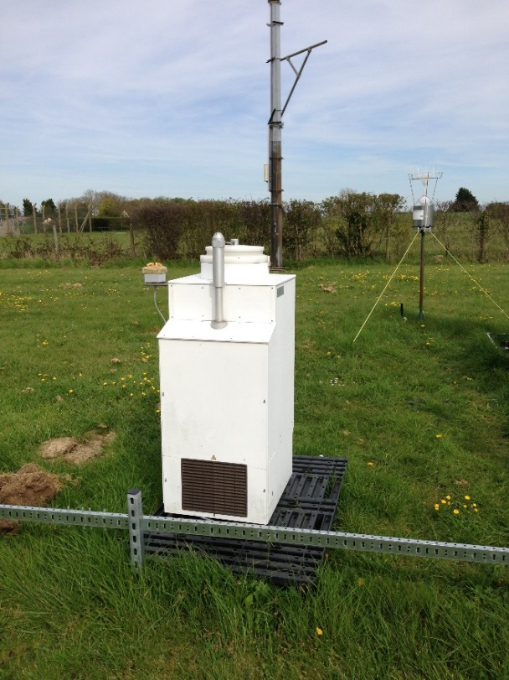
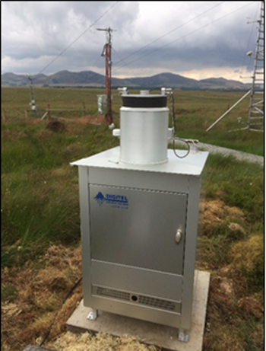
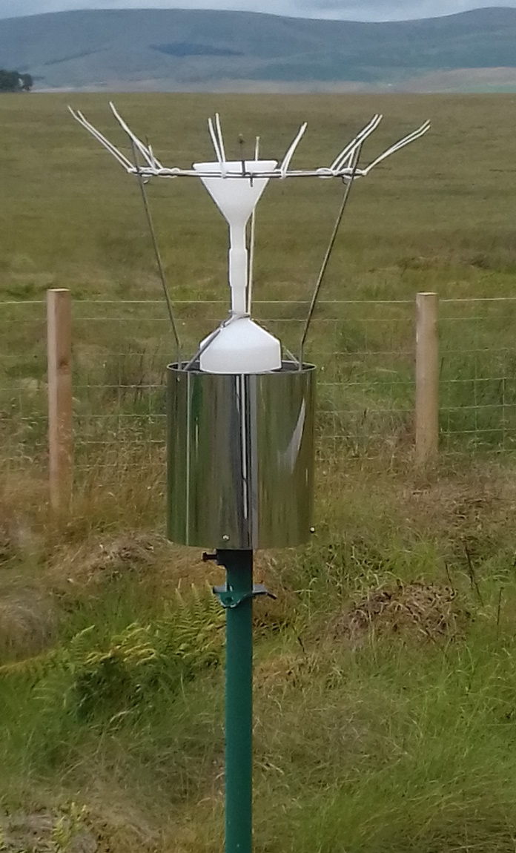
Types of rain collectors
Eigenbrodt wet only
(Daily sampling)
Digitel wet only
(Daily sampling)
WSL Bulk sampler
(Fortnightly sampling)
Notes:
Main content slide. Other slide layouts are available via Home tab > Slides group > Layout.
Edit the project number, confidential level (and client name), date and document number (RD or for proposals use B&T number) in the footer via View tab > Presentation Views group > Slide Master. Be sure to scroll all the way up to the top “slide master” to edit these, as you can not edit them in the “layouts”. Also go there to remove or edit the “INTERNAL UNAPPROVED DRAFT” tag before releasing to clients.

Slide 8
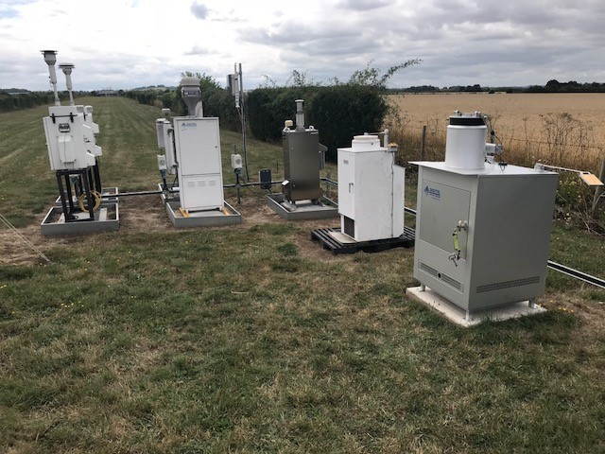
Sampler configuration
Auchencorth Moss
Chilbolton

Slide 9
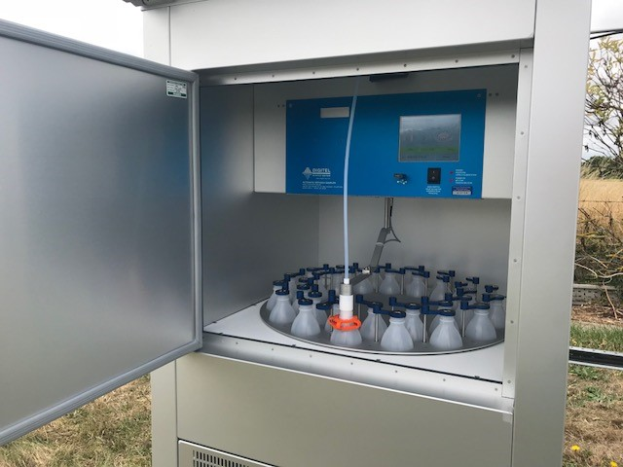
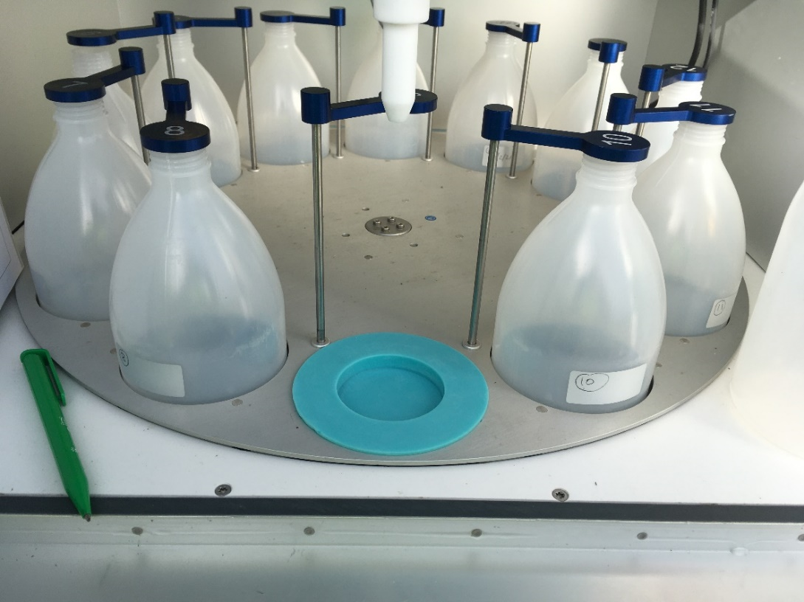
Bottle configuration
Originally 30 bottles on carousel
Needed combining into daily samples
Now 12 bottles on carousel
(Since April 2020)

Slide 10
Method of comparison
Scatter plots between wet only samplers
Aggregate daily volumes (for rain gauge, Eigenbrodt and Ditigel) to fortnightly sampling periods and relate to known operational issues
Calculate volume weighted concentrations for sulphate, nitrate and ammonium for each two week sampling period and relate to known operational issues
Compare the annual volume weighted mean for sulphate, nitrate and ammonium at both sites and for both 2019 and 2020
Notes:
Main content slide. Other slide layouts are available via Home tab > Slides group > Layout.
Edit the project number, confidential level (and client name), date and document number (RD or for proposals use B&T number) in the footer via View tab > Presentation Views group > Slide Master. Be sure to scroll all the way up to the top “slide master” to edit these, as you can not edit them in the “layouts”. Also go there to remove or edit the “INTERNAL UNAPPROVED DRAFT” tag before releasing to clients.

Slide 11
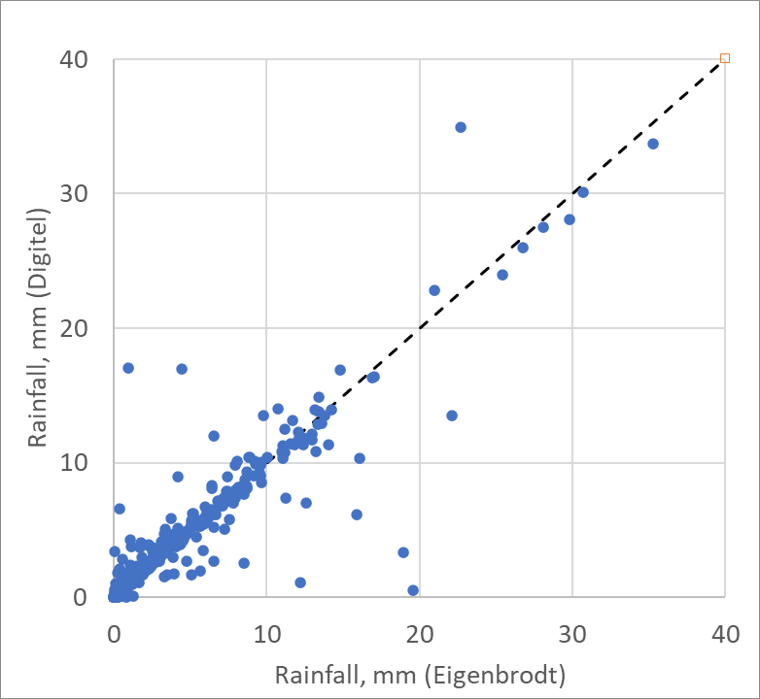
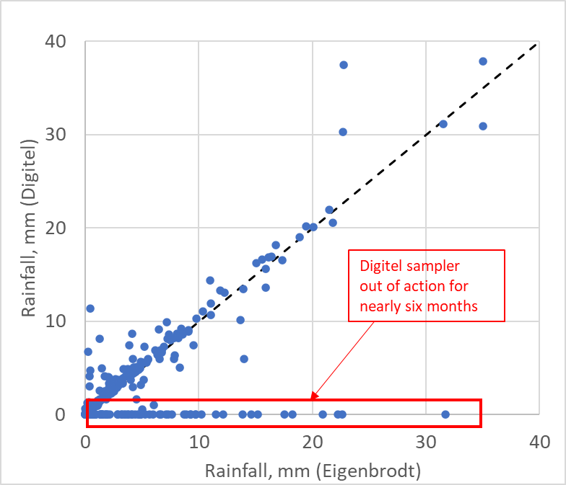
Rain volumes – daily samples
Auchencorth Moss
Chilbolton
Notes:
Main content slide. Other slide layouts are available via Home tab > Slides group > Layout.
Edit the project number, confidential level (and client name), date and document number (RD or for proposals use B&T number) in the footer via View tab > Presentation Views group > Slide Master. Be sure to scroll all the way up to the top “slide master” to edit these, as you can not edit them in the “layouts”. Also go there to remove or edit the “INTERNAL UNAPPROVED DRAFT” tag before releasing to clients.

Slide 12
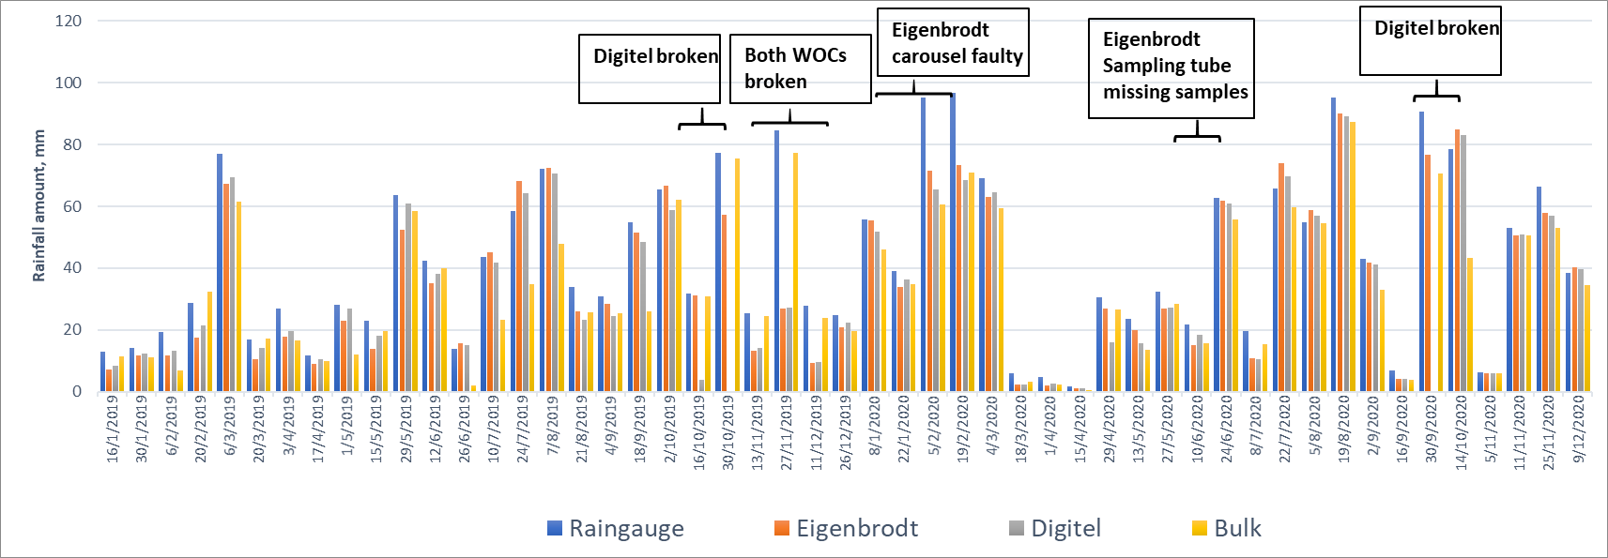
Rain volumes at Auchencorth Moss
Notes:
Main content slide. Other slide layouts are available via Home tab > Slides group > Layout.
Edit the project number, confidential level (and client name), date and document number (RD or for proposals use B&T number) in the footer via View tab > Presentation Views group > Slide Master. Be sure to scroll all the way up to the top “slide master” to edit these, as you can not edit them in the “layouts”. Also go there to remove or edit the “INTERNAL UNAPPROVED DRAFT” tag before releasing to clients.

Slide 13
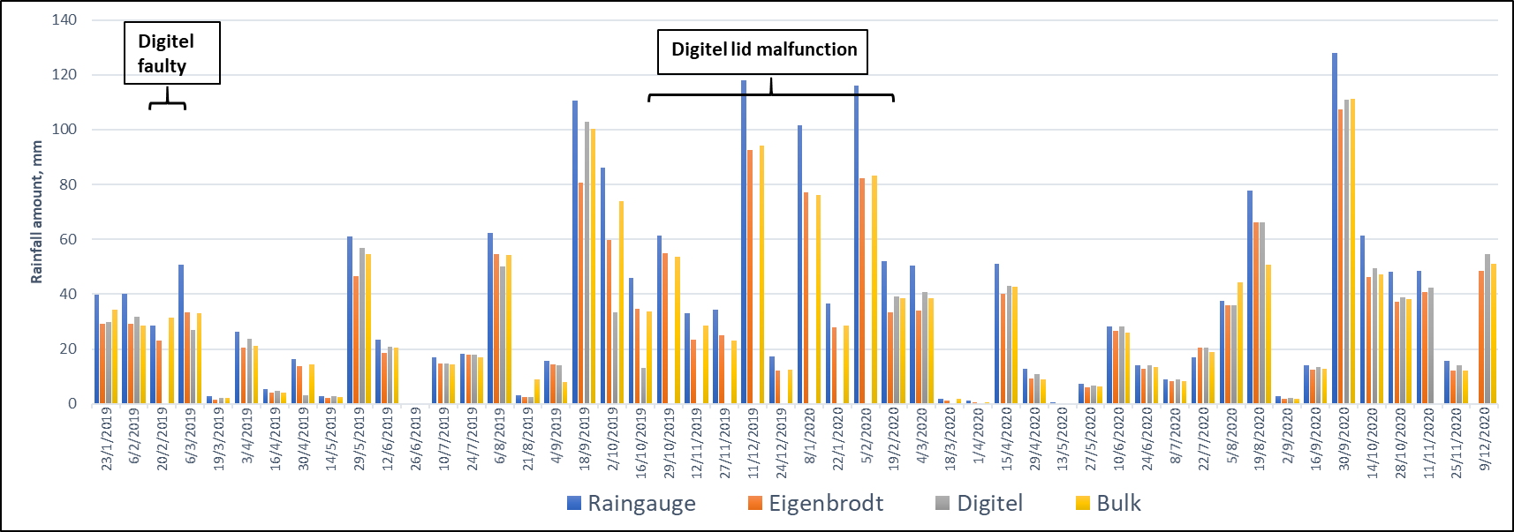
Rain volumes at Chilbolton
Notes:
Main content slide. Other slide layouts are available via Home tab > Slides group > Layout.
Edit the project number, confidential level (and client name), date and document number (RD or for proposals use B&T number) in the footer via View tab > Presentation Views group > Slide Master. Be sure to scroll all the way up to the top “slide master” to edit these, as you can not edit them in the “layouts”. Also go there to remove or edit the “INTERNAL UNAPPROVED DRAFT” tag before releasing to clients.

Slide 14
Sulphate-S at Auchencorth Moss
Notes:
Main content slide. Other slide layouts are available via Home tab > Slides group > Layout.
Edit the project number, confidential level (and client name), date and document number (RD or for proposals use B&T number) in the footer via View tab > Presentation Views group > Slide Master. Be sure to scroll all the way up to the top “slide master” to edit these, as you can not edit them in the “layouts”. Also go there to remove or edit the “INTERNAL UNAPPROVED DRAFT” tag before releasing to clients.

Slide 15
Nitrate-N at Auchencorth Moss
Notes:
Main content slide. Other slide layouts are available via Home tab > Slides group > Layout.
Edit the project number, confidential level (and client name), date and document number (RD or for proposals use B&T number) in the footer via View tab > Presentation Views group > Slide Master. Be sure to scroll all the way up to the top “slide master” to edit these, as you can not edit them in the “layouts”. Also go there to remove or edit the “INTERNAL UNAPPROVED DRAFT” tag before releasing to clients.

Slide 16
Ammonium-N at Auchencorth Moss
Notes:
Main content slide. Other slide layouts are available via Home tab > Slides group > Layout.
Edit the project number, confidential level (and client name), date and document number (RD or for proposals use B&T number) in the footer via View tab > Presentation Views group > Slide Master. Be sure to scroll all the way up to the top “slide master” to edit these, as you can not edit them in the “layouts”. Also go there to remove or edit the “INTERNAL UNAPPROVED DRAFT” tag before releasing to clients.

Slide 17
Comparison of annual means
Notes:
Main content slide. Other slide layouts are available via Home tab > Slides group > Layout.
Edit the project number, confidential level (and client name), date and document number (RD or for proposals use B&T number) in the footer via View tab > Presentation Views group > Slide Master. Be sure to scroll all the way up to the top “slide master” to edit these, as you can not edit them in the “layouts”. Also go there to remove or edit the “INTERNAL UNAPPROVED DRAFT” tag before releasing to clients.

Slide 18
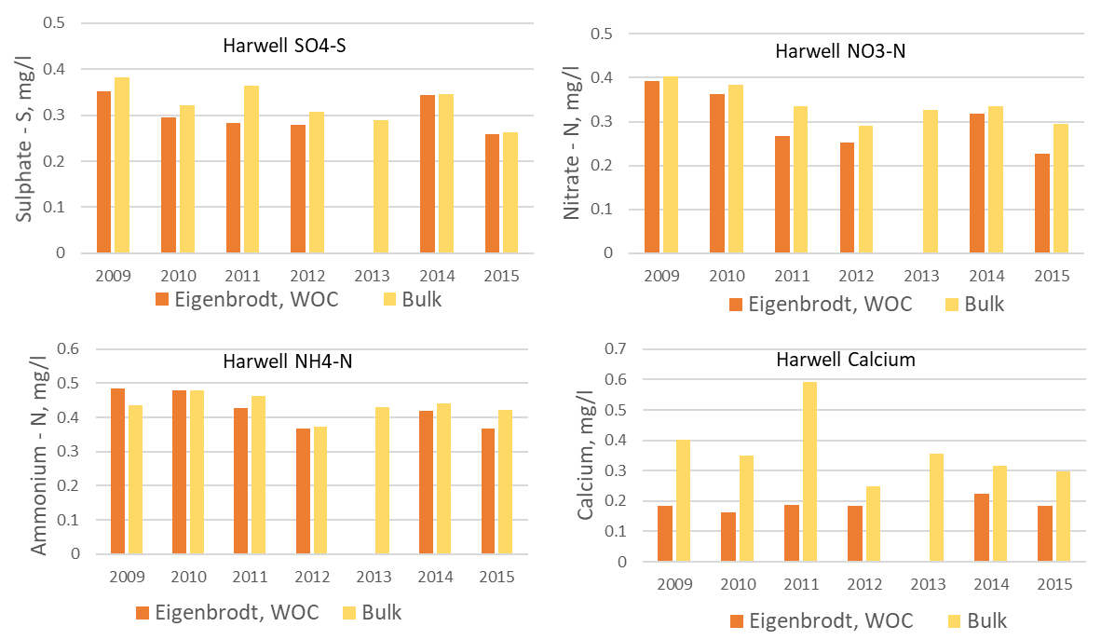
Difference between WOC and Bulk at former Supersite at Harwell
Difference between WOC and bulk – typically between 5 % and 20 %
Difference for calcium between 30 % and 70 %
Notes:
Main content slide. Other slide layouts are available via Home tab > Slides group > Layout.
Edit the project number, confidential level (and client name), date and document number (RD or for proposals use B&T number) in the footer via View tab > Presentation Views group > Slide Master. Be sure to scroll all the way up to the top “slide master” to edit these, as you can not edit them in the “layouts”. Also go there to remove or edit the “INTERNAL UNAPPROVED DRAFT” tag before releasing to clients.

Slide 19
Conclusions
Operationally, Eigenbrodt wet only collector is more robust and more simple in design.
Digitel had design issues- instrument could not be used as an EMEP daily wet only collector without instrument modifications.
Digitel requires more LSO training, care, and takes longer to change weekly samples
Digitel does record additional variables (environmental and operational)
Regular comparison to rain gauge data to ensure wet only operating correctly is very important
Experiment demonstrates the importance of a minimum of a 24 month measurement overlap when changing any instruments at an EMEP site
Notes:
Main content slide. Other slide layouts are available via Home tab > Slides group > Layout.
Edit the project number, confidential level (and client name), date and document number (RD or for proposals use B&T number) in the footer via View tab > Presentation Views group > Slide Master. Be sure to scroll all the way up to the top “slide master” to edit these, as you can not edit them in the “layouts”. Also go there to remove or edit the “INTERNAL UNAPPROVED DRAFT” tag before releasing to clients.

Slide 20
Keith Vincent
Keith.vincent@ricardo.com

